Slide 1


BVRIT HYDERABAD
College of Engineering for Women Department of Information Technology
Title :GAMING APPLICATION FOR ALZHEIMER’S DISEASE DETECTION
Date: 17-11-2022
Team - 1
K.Sanjana Reddy(19WH1A1219) M.Deepthi Sharvani(19WH1A1220) R.Rajani(19WH1A1241) K.Aarthi(19WH1A1258)
Internal Guide: Dr.Aruna Rao S.L Professor & HoD

Slide 2
AGENDA
Introduction
Existing system
Problem statement
Literature Survey
Proposed system
Tools and Technologies
Feasibility Study
Social impact
Architecture
Modules
UML Diagram
Implementation
Partial Results
Project timeline
References

Slide 3
INTRODUCTION
Alzheimer's disease is a progressive neurological disorder that causes the brain to shrink and brain cells to die.
Memory loss, bad decisions, loss of spontaneity, taking longer to complete normal daily tasks and so on are the major symptoms of Alzheimer's disease.
Symptoms of this disease depend on the stage of the disease, where they usually develop slowly and get worse over time.
There are over 10 million new cases of dementia each year worldwide, implying one new case every 3.2 seconds.

Slide 4
EXISTING SYSTEM
To diagnose Alzheimer's dementia, doctors evaluate memory, language, visual perception, attention, problem solving, movement, senses, balance, reflexes and other areas of patient.
CT scans or MRI scans are the most common type of brain scans used in dementia diagnosis.
PET scans show patterns of brain activity and hallmarks of Alzheimer's disease.

Slide 5
PROBLEM STATEMENT:
People never prefer to visit doctor until the symptoms get intensified, which generally happens in later stages of disease. CT scans, MRI scans and PET scans are performed when prescribed by doctor only. Hence diagnosing the disease and providing the proper medication for the patient in early stages of disease, will help in preventing the serious effects caused by the disease in later stages. So we are developing the mobile application to diagnose the disease in early stages.

Slide 6
LITERATURE SURVEY
SNO | Title of the paper | Author(s) & Journal Details | Description
1 | Rapid improvement in Alzheimer’s disease symptoms following fecal microbiota transplantation: a case report. | Sabine Hazan(2020), SAGE Journals | Alzheimer’s disease (AD), the most common form of dementia, is a leading cause of death and a major cause of morbidity in older people.Advancing age is the most significant risk factor for the disease, with incidence doubling every 5 years after the age of 65.
2 | Early Detection of Alzheimer’s Disease Using Magnetic Resonance Imaging: A Novel Approach Combining Convolutional Neural Networks and Ensemble Learning | Dan Pan, An Zeng, Longfei Jia, Yin Huang, Tory Frizzell and Xiaowei Song(2020), frontiers | Early detection is critical for effective management of Alzheimer’s disease. Among several deep learning techniques that have been applied to assessing structural brain changes on MRI,CNN has gained popularity due to its superb efficiency in automated feature learning with the use of a variety of multi-layer perceptron.

Slide 7
3 | Late-onset Alzheimer Disease | Dr Gil D. Rabinovici, University of California San Francisco Memory and Aging Center(2019), National Library of Medicine. | Approximately 80% of patients with AD are older than age 75, with disease incidence increasing from 2 per 1000 at ages 65 to 74 to 37 per 1000 at age 85 and older.

Slide 8
PROPOSED SYSTEM
Aim is to develop an android application to detect dementia in early stages.
Our android application gives the level of Alzheimer's in a patient which helps to keep track of patient’s condition.
Our application consists of various games conducted in levels which helps to know the degree of disease like mild, moderate or severe.

Slide 9
TOOLS AND TECHNOLOGY
Environment | Specifications
Hardware | Processor - Intel core i5 Memory(RAM) - 8GB Android phone
Software | Language - Java OS - Windows 10 Android studio

Slide 10
FEASIBILITY STUDY
We are using Java as a development language for our android application, due to its versatile , platform independent nature and availability of wide range of inbuilt functions.
We have planned to use XML to create layout files. Unlike HTML, XML is case-sensitive, requires each tag be closed, and preserves white space.
We are using android studio due to its unified environment which enables us to divide our project into units of functionality that we can independently build, test, and debug.

Slide 11
SOCIETAL IMPACT
Dementia has significant social and economic implications in terms of direct medical and social care costs, and the costs of informal care. The annual global cost of dementia is now above $ 1.3 trillion.
Physical, emotional and financial pressures can cause great stress to families and carers, and support is required from the health, social, financial and legal systems.

Slide 12
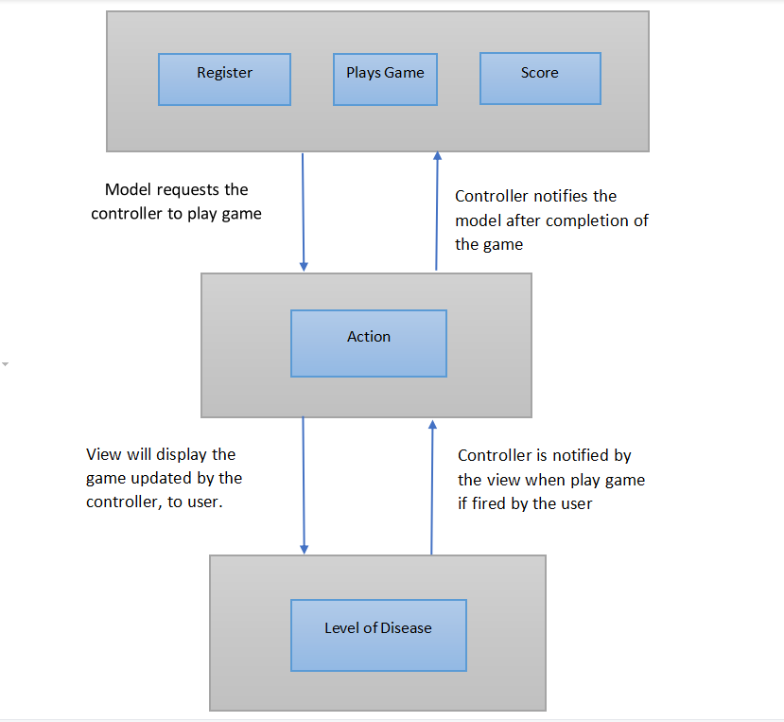
ARCHITECTURE

Slide 13
MODULES
Module 1: Registration
Module 2: Game Design [Level-1 , Level -2 ,Level -3]
Module 3: Analyze the level of disease

Slide 14
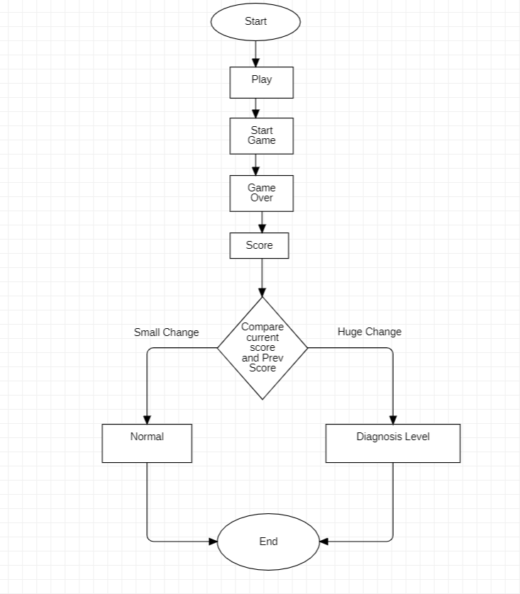
UML DIAGRAM

Slide 15
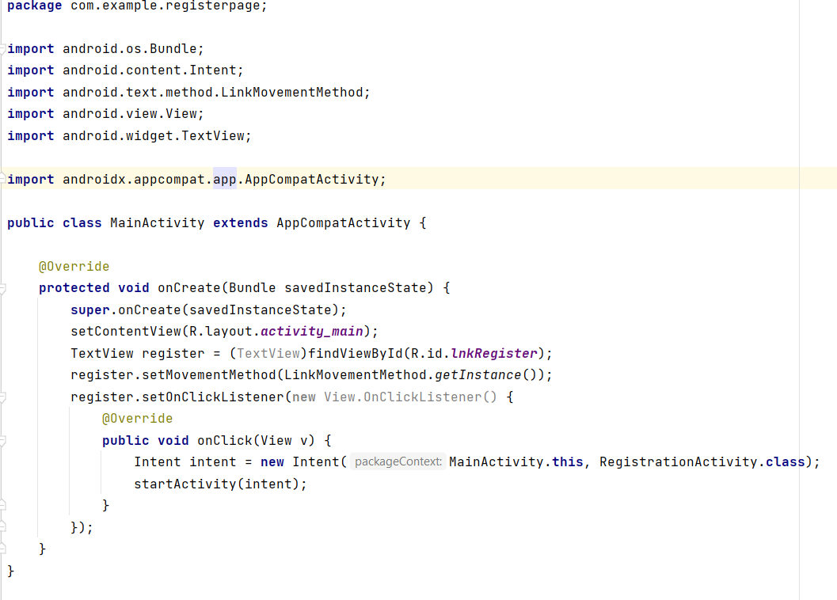
Module 1: Registration Page Implementation

Slide 16
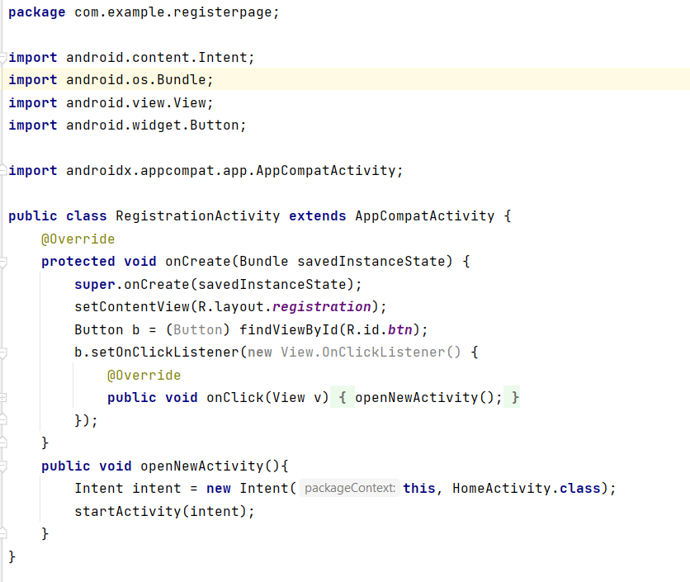
Module 1: Registration Page Implementation

Slide 17
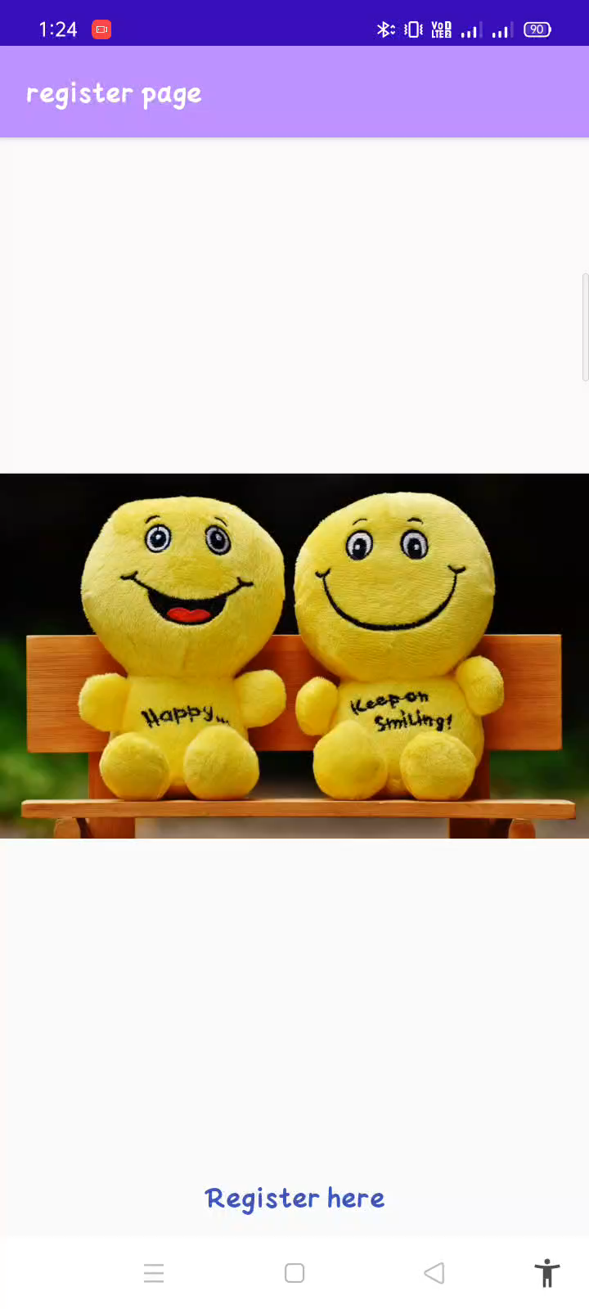
Module 1: Partial Result

Slide 18
PROJECT TIMELINE
Dates | Duration | Tasks | Status
PHASE -1
26.9.2022-2.10.2022 | 1 week | Title finalization | Completed
11.10.2022 - 07.10.2022 | 2 week | Literature Survey | Completed
08.10.2022 - 19.11.2022 | 1.5 weeks | Abstract submission and PPT preparation. | Completed
20.11.2022 - 05.12.2022 | 2 weeks | Architecture design | Completed
06.12.2022 - 26.12.2022 | 3 weeks | Module 1 Implementation | 90% Completed
27.12.2022 - 02.1.2023 | 3 weeks | Module 2 Implementation ( Level 1) | Yet to start
PHASE - 2
13.02.2023 - 14.03.2023 | 3 weeks | Module 2 Implementation ( Level 2) | Yet to start
15.03.2023 – 05.04.2023 | 3 weeks | Module 2 Implementation ( Level 3) | Yet to start
06.04.2023-27.04.2023 | 3 weeks | Module 3 Implementation | Yet to start

Slide 19
REFERENCES
[1] Kanwal Yousaf ,Zahid Mehmood ,Israr Ahmad Awan ,Tanzila Saba ,Riad Alharbey , Talal Qadah
and Mayda Abdullateef Alrige, “A comprehensive study of mobile-health based assistive
technology for the healthcare of dementia and Alzheimer’s disease (AD ) ” , Health care
management science , https://doi.org/10.1007/s10729-019-09486-0,Springer Science+Business
Media, LLC, part of Springer Nature 2019.
[2] Subetha T, Rashmita Khilar,Sarat Kumar Sahoo “An Early Prediction and Detection of Alzheimer's
Disease: A Comparative Analysis on Various Assistive Technologies” IEEE 2020.
[3] Mayoclinic Org "Patient care and Health Information: Diagnosis and Treatment" 2019.
[4] Dementia. In: World Health Organization [website]. Geneva: World Health Organization; 2020.
[5] Areej Y. Bayahya , Wadee Alhalabi , Sultan H. AlAmri ," Smart Health System to Detect Dementia
Disorders Using Virtual Reality" , National Library of Medicine 2021.
[6] Dan Pan, An Zeng, Longfei Jia, Yin Huang, Tory Frizzell and Xiowei song “Early Detection of Alzheimer’s
Disease Using Magnetic Resonance Imaging: A Novel Approach Combining Convolutional Neural
Networks and Ensemble Learning” frontiersin.org/articles/10.3389/fnins.2020.00259/full.

Slide 20
THANK YOU

